Slide 1
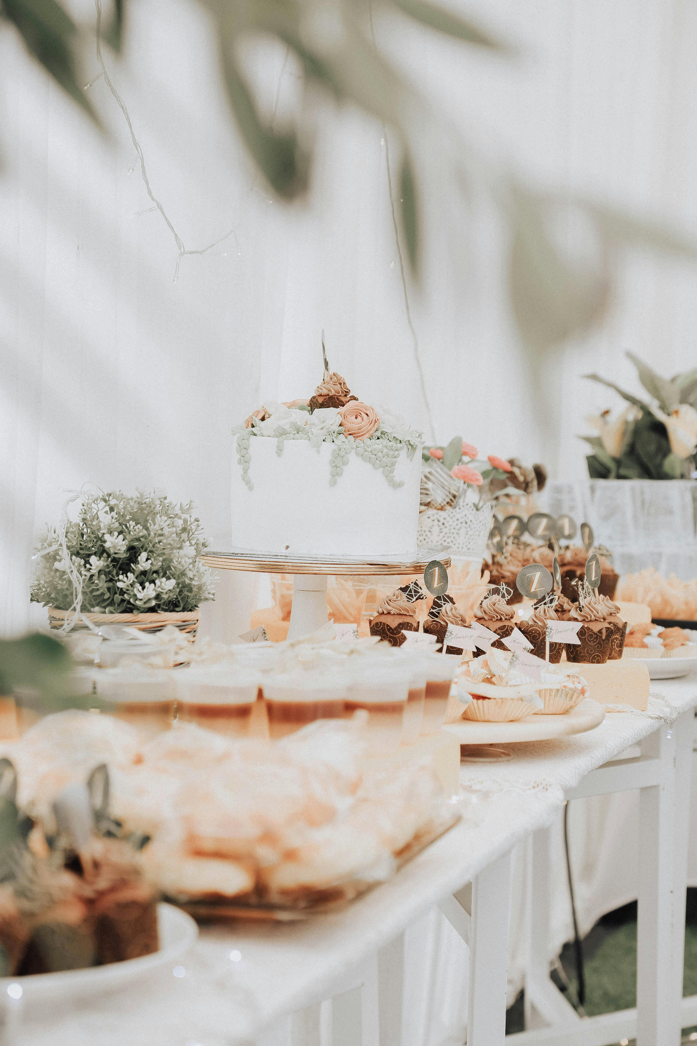
Cake’s
World

Slide 2


Home
Available cakes
Order a cake
We make special celebration cakes. Please find information below about what to expect from our service
We are available to get order Monday to Sunday
There are 35 different our brand flavour of cakes that you can choose in our store
Costumer can choose their own flavour and decoration for their celebration. Currently, we are receiving 4 types of big celebration cake orders.
The preparation time of the cake depends on the order. However, average time of making cake is 1 to 2 days.
We do some celebration cake party in our store which can choose special decorated room. Furdermore, there many service included such as song, dance and record the special moment.
We do have some special day discounts and gift cards which you can get discount from every your order
Cake’s
World
A Slice of Love
Welcome to our unique cake shop.
Get in touch
Branch | Contact name | Phone number
Dublin | Shoen | 0004563790
Galway | Romano | 0007894790
Cork | Andrew | 0002328790
All rights reserved XMLWC

Slide 3
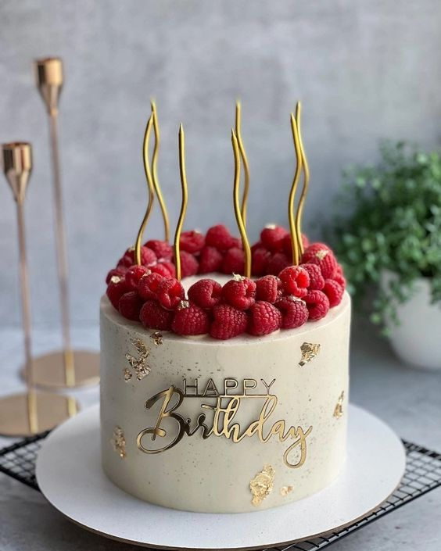
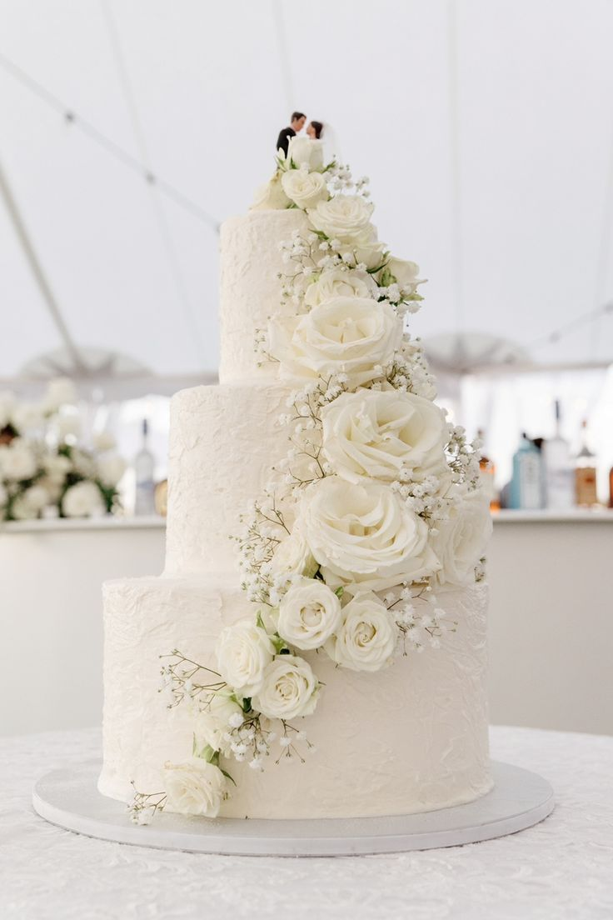
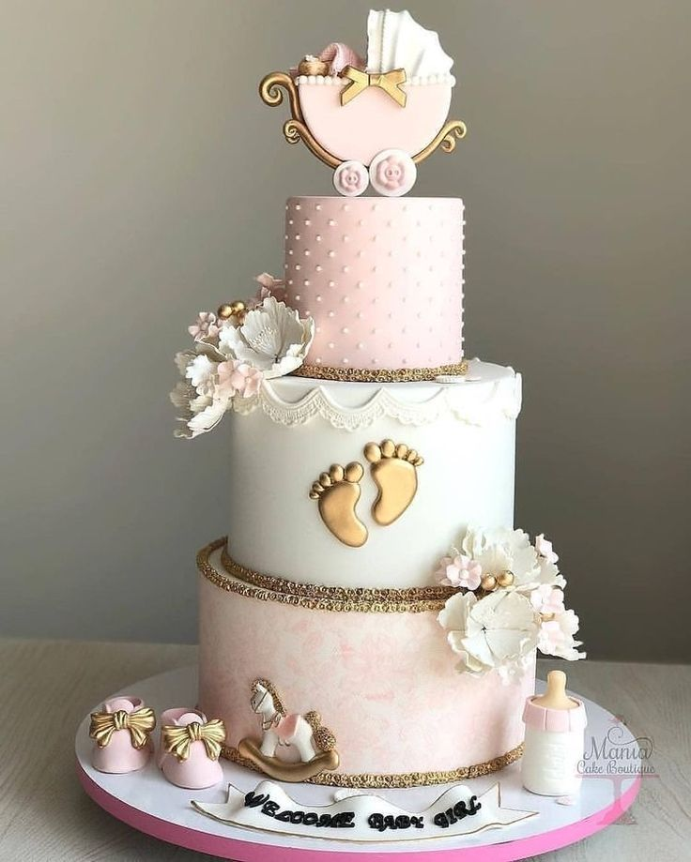
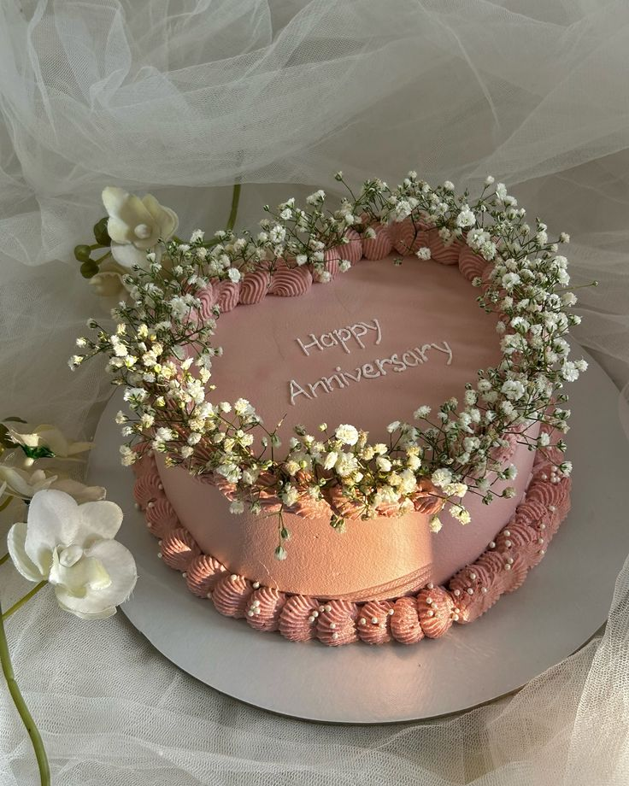
Home
Available cakes
Order a cake
A Slice of Love
Birthday cake
Starting price: 45 euro
Wedding cake
Starting price: 100 euro
Baby shower cake
Starting price: 65 euro
Anniversary cake
Starting price: 55 euro
All rights reserved XMLWC

Slide 4
Home
Available cakes
Order a cake
Cake order form
Your name*
Your phone number*
Your email*
How would you like us to contact you?
Phone
Email
Your desired cake
Birthday
Do you want to leave us any additional comment
I agree to your T&C
I would like to subcribe your monthly newsletter
All rights reserved XMLWC

Slide 5
Source
 | Subject | Resource
1 | Logo picture | https://www.pinterest.com/pin/784400460125580727/
2 | HomePagePicture | Source of picture: https://www.pexels.com/photo/selective-focus-photo-of-pastries-on-table-1748863/
3 | All the text, phone number, and informations | I created them by my own
4 | Birthday cake | https://ie.pinterest.com/pin/361202832634112168/
5 | Wedding cake | https://ie.pinterest.com/pin/654851602103520630/
6 | Anniversary cake | https://ie.pinterest.com/pin/744008800975565384/
7 | Homepage and orderpage background picture | https://www.pinterest.com/pin/817684876112106998/
8 | Baby shower cake | https://ie.pinterest.com/pin/1618549863629791/

